Slide 1





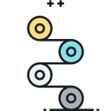


사각지대 위험인식 프로그램 HEAD-UP
종합설계프로젝트
1차 보고서
과제명 : 사각지대 위험인식 프로그램
팀번호 : 4조
멘토기업명 : SKT
Capstone Design Project
1st Report
Assignment Name : Blind Spot Risk Recognition Program
Team Number : 4th
Mentor Company: SKT

Slide 2
사각지대 위험인식 프로그램 HEAD-UP
INDEX
Introduction Team Member
Project Evaluation
Project Selection
Project Necessity
Development Trend
Weekly Work Plan
Online Process Tool

Slide 3
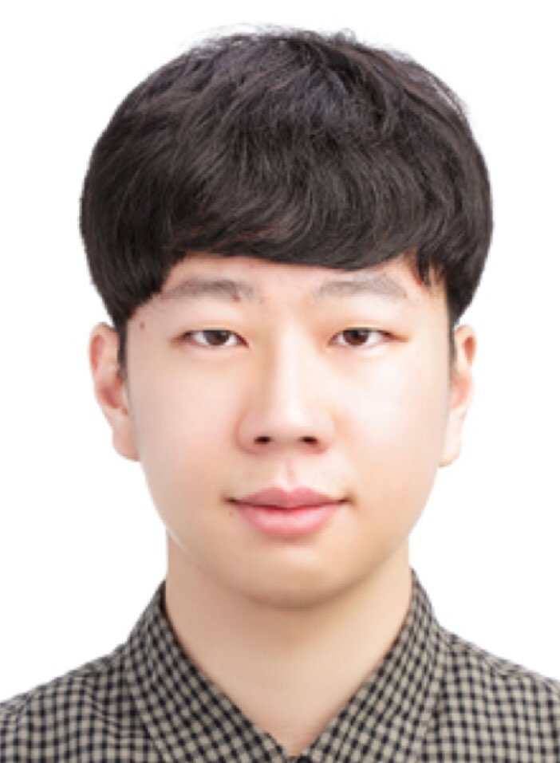
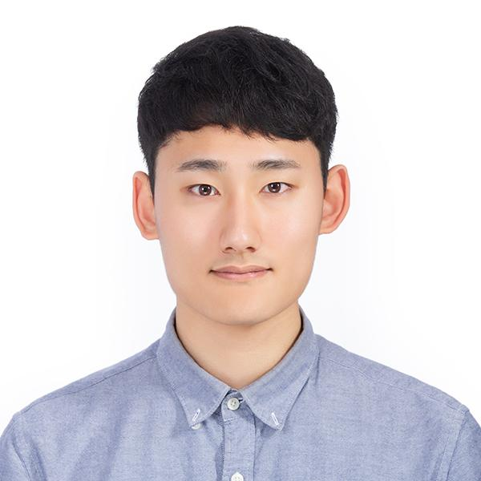
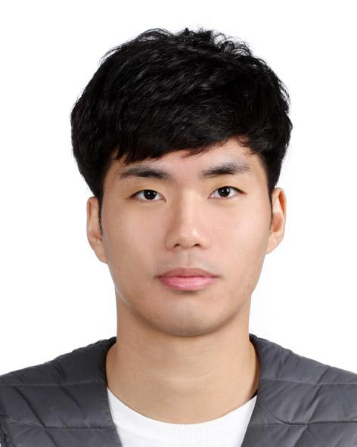
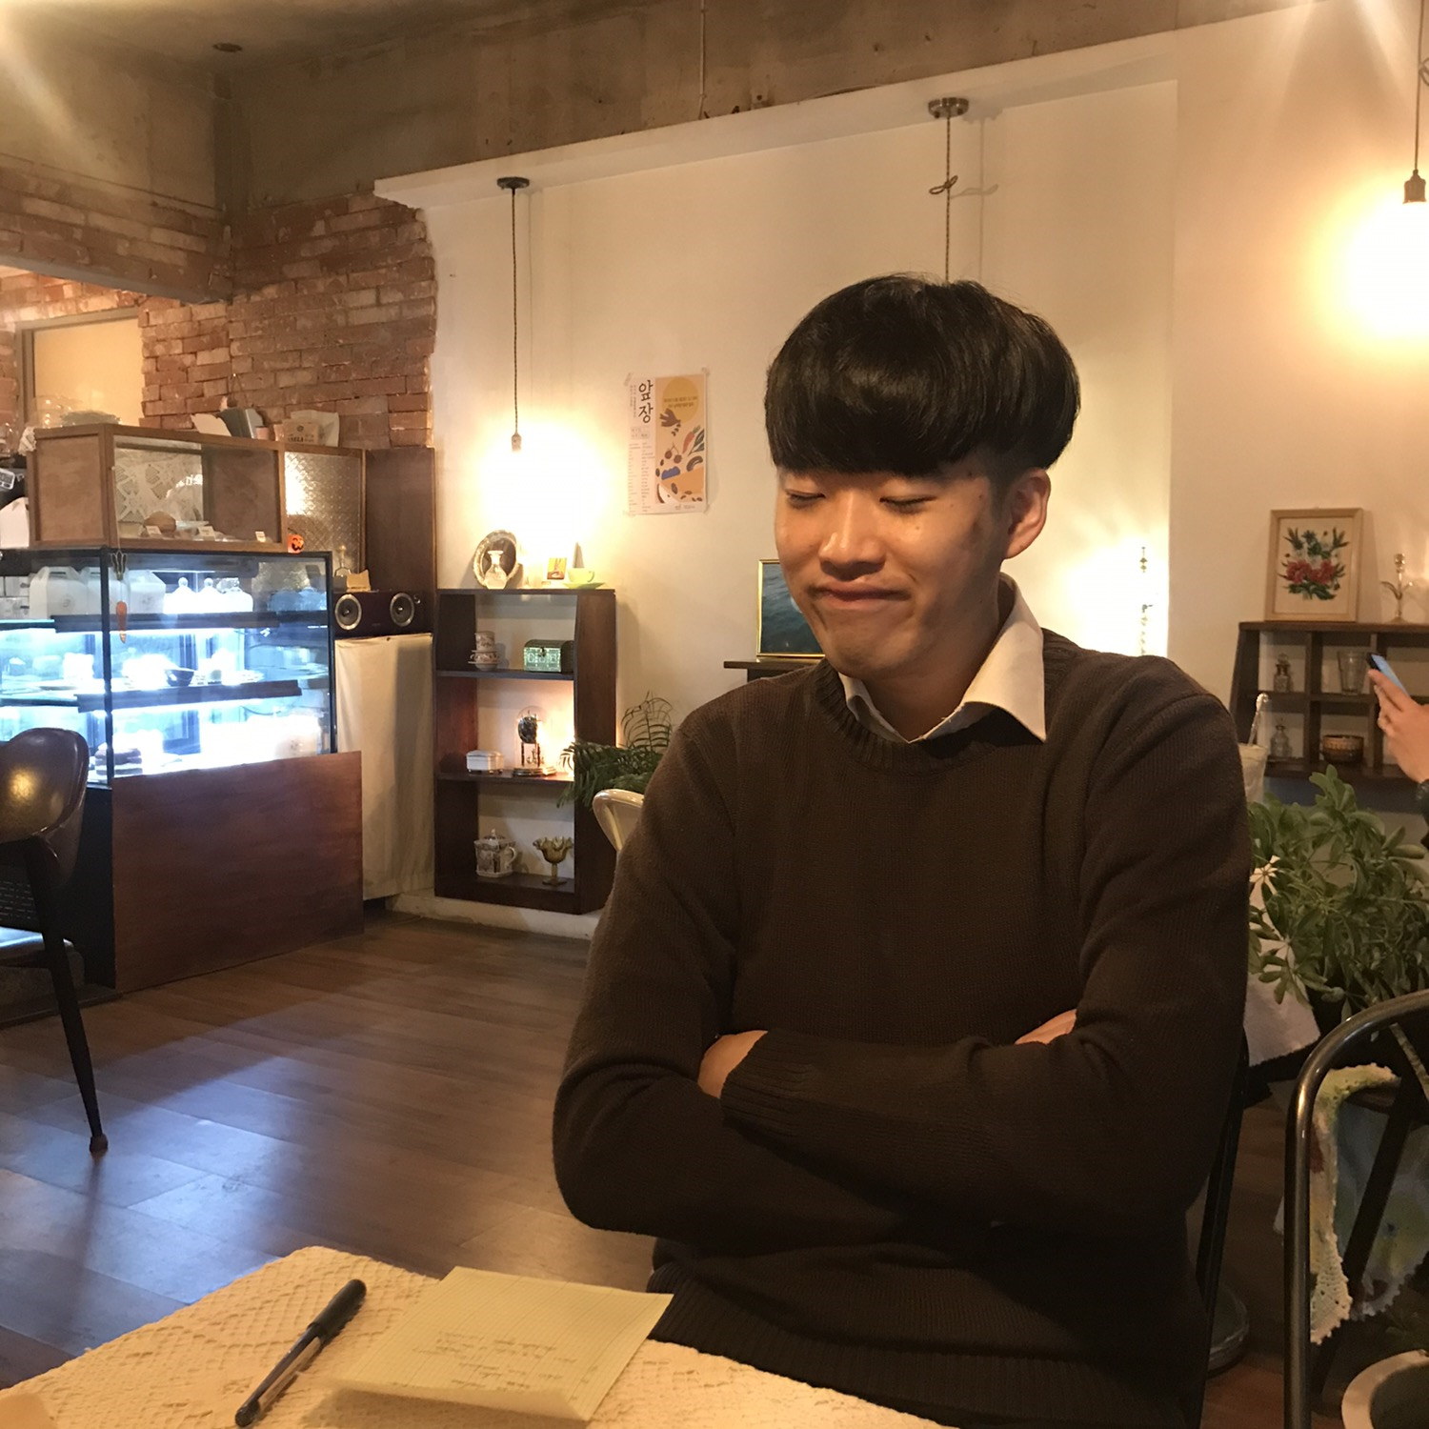
Introduction Team Member
사각지대 위험인식 프로그램 HEAD-UP
김준영 (Junyeong Kim)
김형진 (Hyeogjin Kim)
Update the Documents Manage Idea Meeting and Mentoring Meeting
Check Weekly Plan
박주홍 (Juhong Park)
심재욱 (Jaeuk Sim)
Update Shared Software Hardware Management
Update Shared Technique Information

Slide 4
Project Evaluation
사각지대 위험인식 프로그램 HEAD-UP
Brainstorming the Subjects (Base Subject : Image Processing and A.I)
 | Feasibility | Social Contribution | Creativity | Development Cost | Base Subject Association
Blind Spot Risk Recognition Program | 5 | 5 | 5 | 4 | 5
Pet Accident Prevention Program | 4 | 3 | 5 | 2 | 5
Analysis of TV screens for blind | 1 | 4 | 4 | 2 | 3
Detection of Obstruction for the blind | 2 | 5 | 3 | 2 | 5

Slide 5
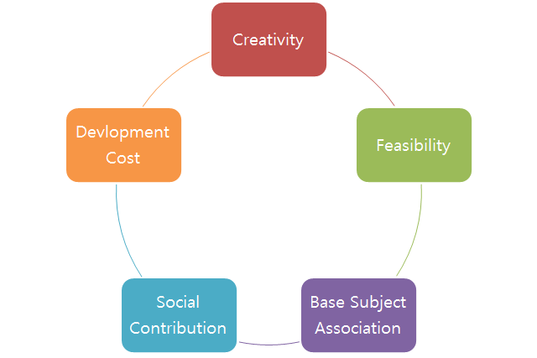

Project Selection
사각지대 위험인식 프로그램 HEAD-UP

Slide 6









Project Necessity
사각지대 위험인식 프로그램 HEAD-UP

Slide 7
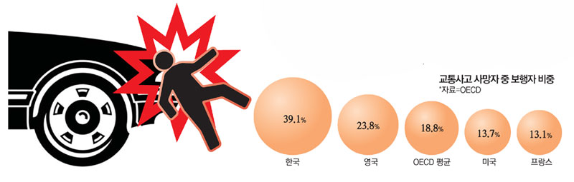
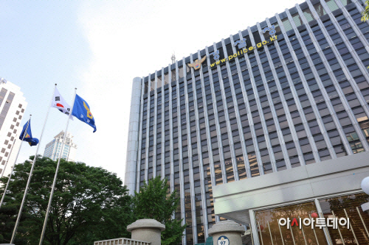
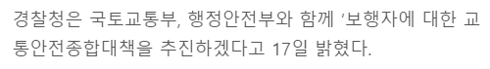
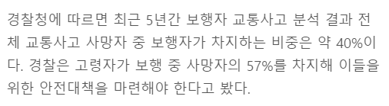

Project Necessity
사각지대 위험인식 프로그램 HEAD-UP
Shortage of policies for pedestrian
출처 : http://www.asiatoday.co.kr/view.php?key=20200217010009733

Slide 8
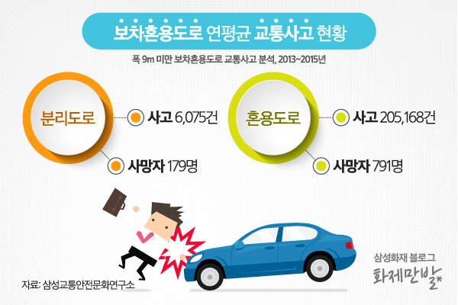
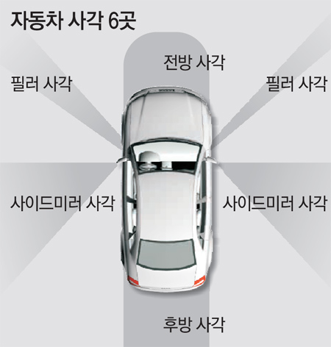
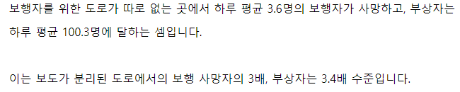
Project Necessity
사각지대 위험인식 프로그램 HEAD-UP
Danger of alley caused by the blind spot of car
출처 : http://www.donga.com/news/article/all/20160408/77466058/1

Slide 9
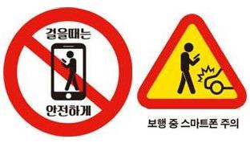
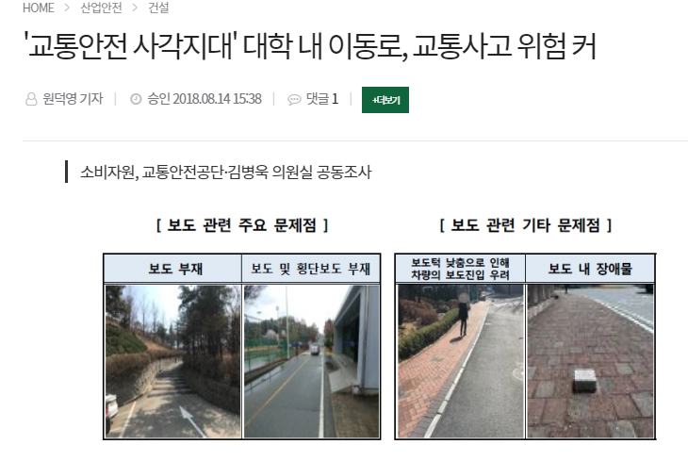
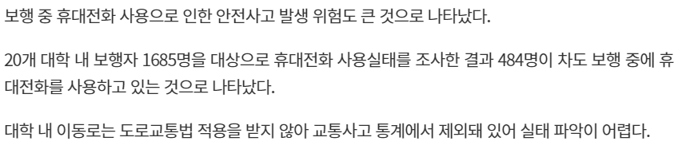
Project Necessity
사각지대 위험인식 프로그램 HEAD-UP
Traffic Accident in universities caused by deadwalkers
출처 : http://www.asiatoday.co.kr/view.php?key=20200217010009733

Slide 10
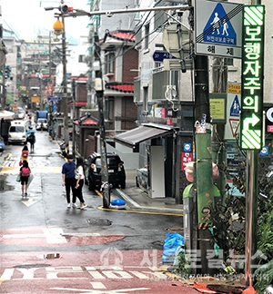
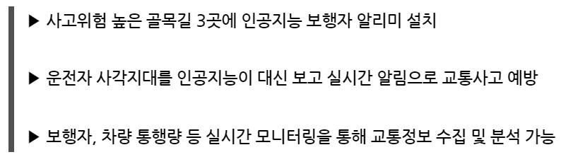

Development Trend
사각지대 위험인식 프로그램 HEAD-UP
Seoul, “A.I Smart Safe Alley” Build Service
출처 : http://www.slnews.co.kr/news/articleView.html?idxno=22297

Slide 11
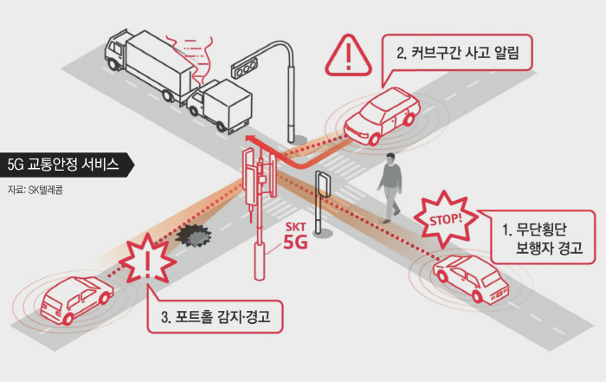
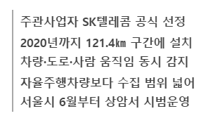
Development Trend
사각지대 위험인식 프로그램 HEAD-UP
SKT, Seoul 5G Networks of Roads, ‘Smart Driving’ Test operation from June
출처 : http://biz.khan.co.kr/khan_art_view.html?artid=201901172055005&code=920501

Slide 12
Weekly Work Plan – First Half
사각지대 위험인식 프로그램 HEAD-UP
1 | Construct Team and Brainstorm Project Subject
2 | Consult the Mentor about Project Subject and Gauge Feasibility
3 | Organize the Program Architecture and Draw up the project budget and Order materials
4 | Write Project Execution Plan and Prepare Interim Presentation
5 | Check the ordered materials and Make Prototypes
6 7 8 | Implement Program

Slide 13
Weekly Work Plan – Second Half
사각지대 위험인식 프로그램 HEAD-UP
9 | Prepare for research paper
10 | Write the research paper
11 12 13 | Optimize Program
14 | Write Result Report
15 | Prepare Final Presentation

Slide 14

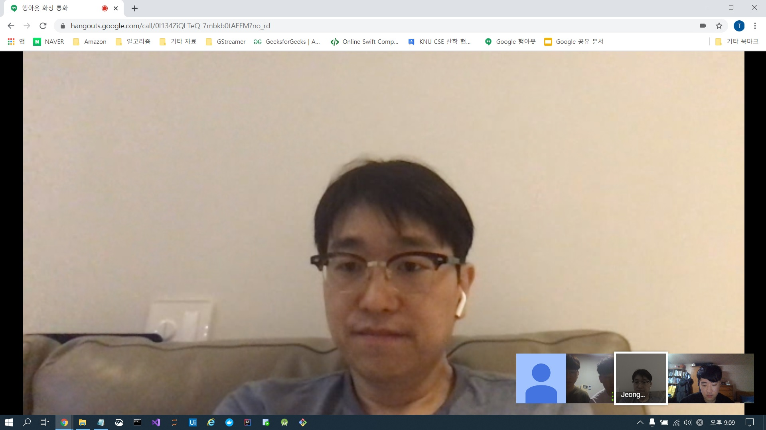

Online Process Tools – Google Hangout
사각지대 위험인식 프로그램 HEAD-UP
03/18 8:00 PM Hangout Conference
03/19 8:00 PM Hangout Conference
Regular Meeting
Web Meeting with team mentor
Every Wednesday 8:00 PM
Ordinary Times Meeting
When team members have free time in common, just come in hangout and proceed the conferences

Slide 15

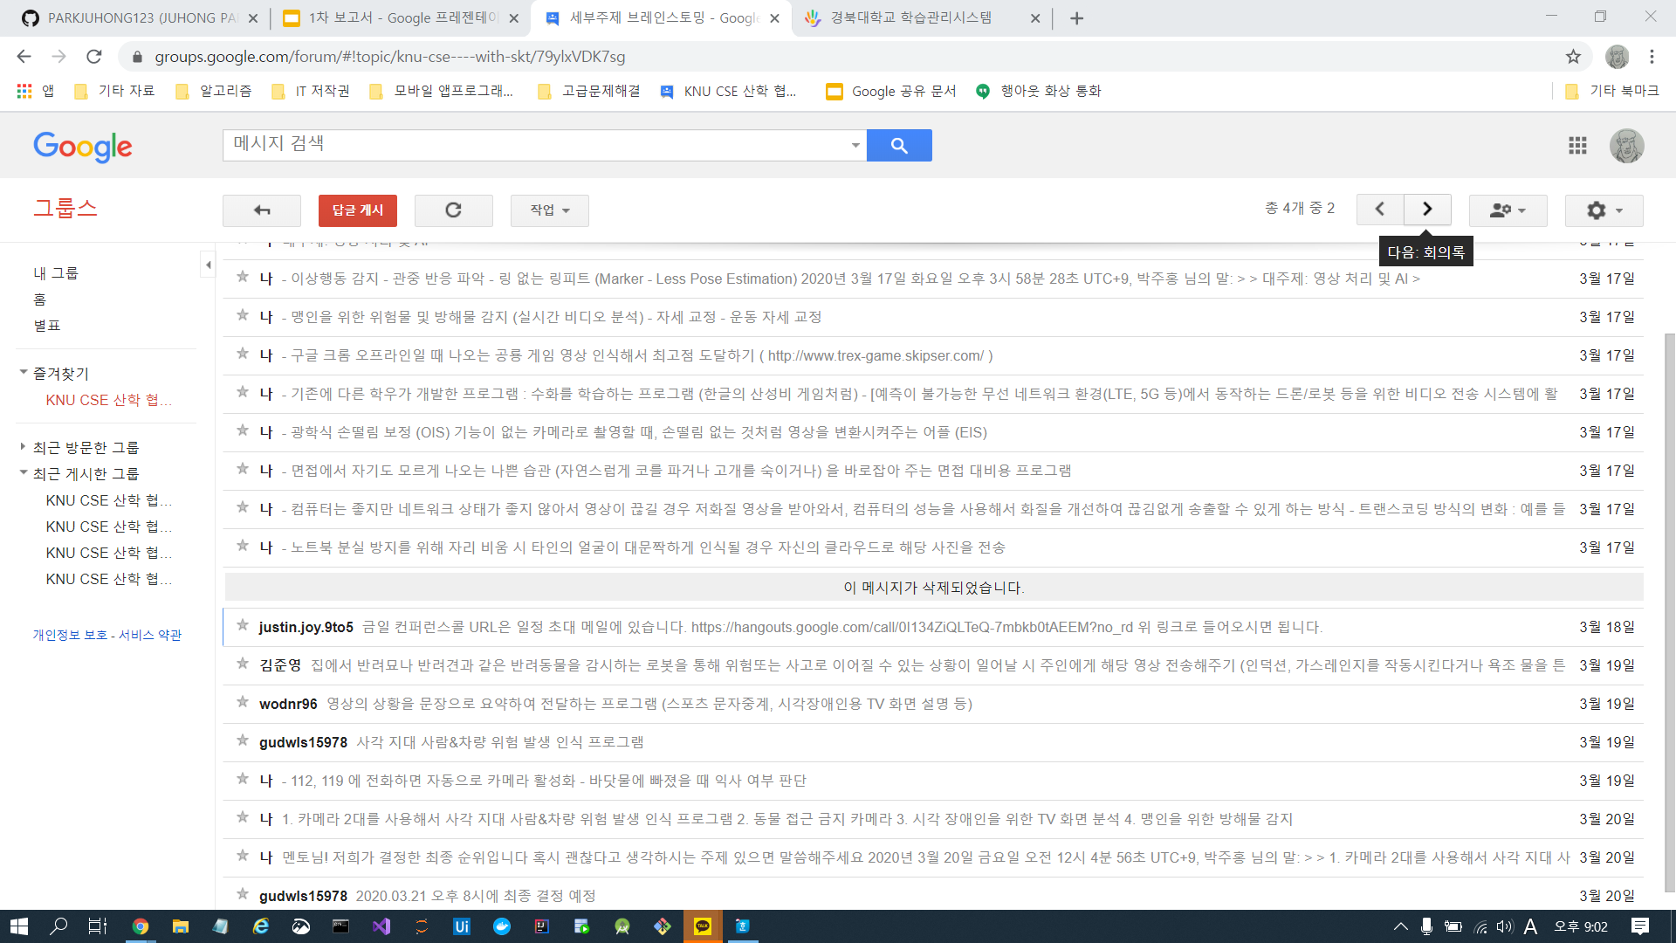
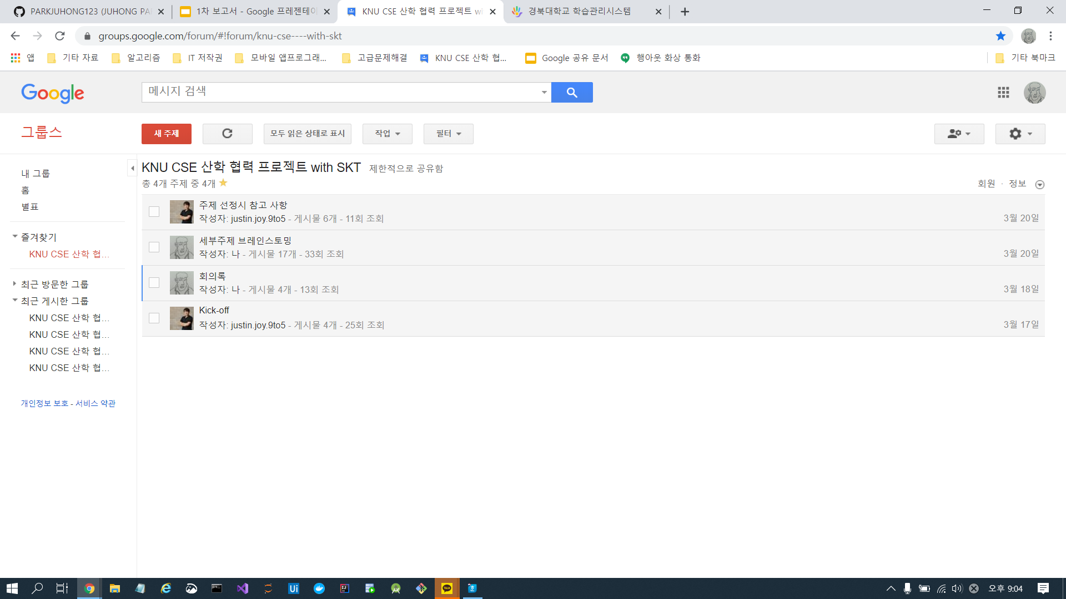
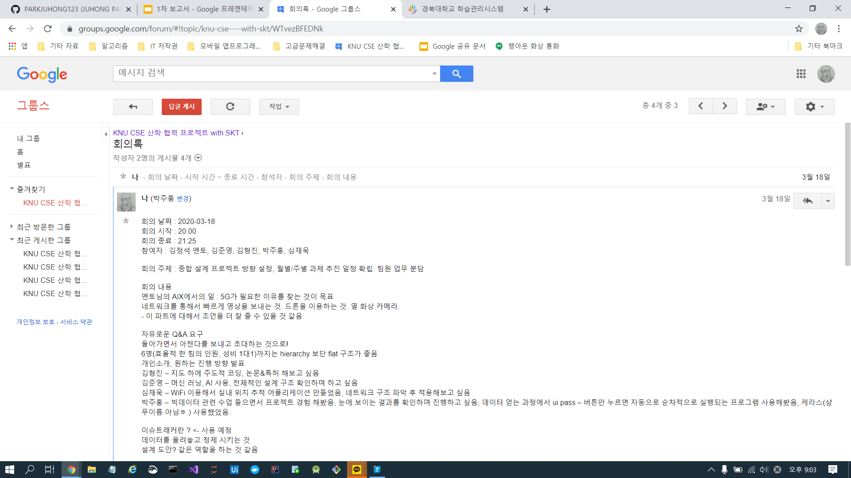
Online Process Tools – Google Groups
사각지대 위험인식 프로그램 HEAD-UP
Google Groups
Share and Save Documents
Every Documents, Conference Contents, Schedule is uploaded and linked in Google Groups

Slide 16

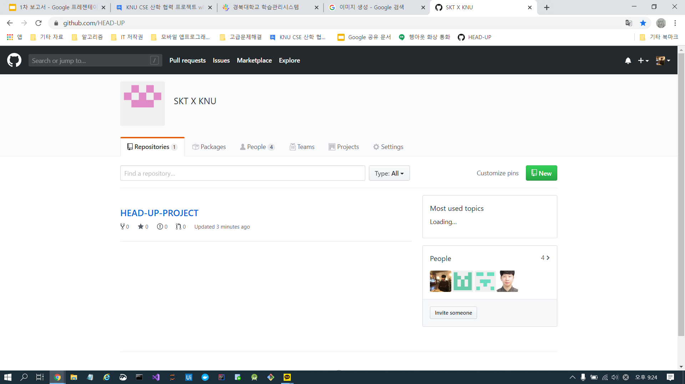
Online Process Tools – Github
사각지대 위험인식 프로그램 HEAD-UP
Github
Github Organization
For Troubleshooting and Issue Tracker
and Project Strong Implementation

Slide 17
사각지대 위험인식 프로그램 HEAD-UP
Thank you.
QnA

